Slide 1
2015 Conference Speakers and Pictures

Slide 2
Tom Szaky, CEO of TerraCycle

Slide 3
Elizabeth Cline Author of Over Dressed The Shockingly High Cost of Cheap Fashion

Slide 4
Chris Ladd, Director and CFO of Closed Loop Fund

Slide 5
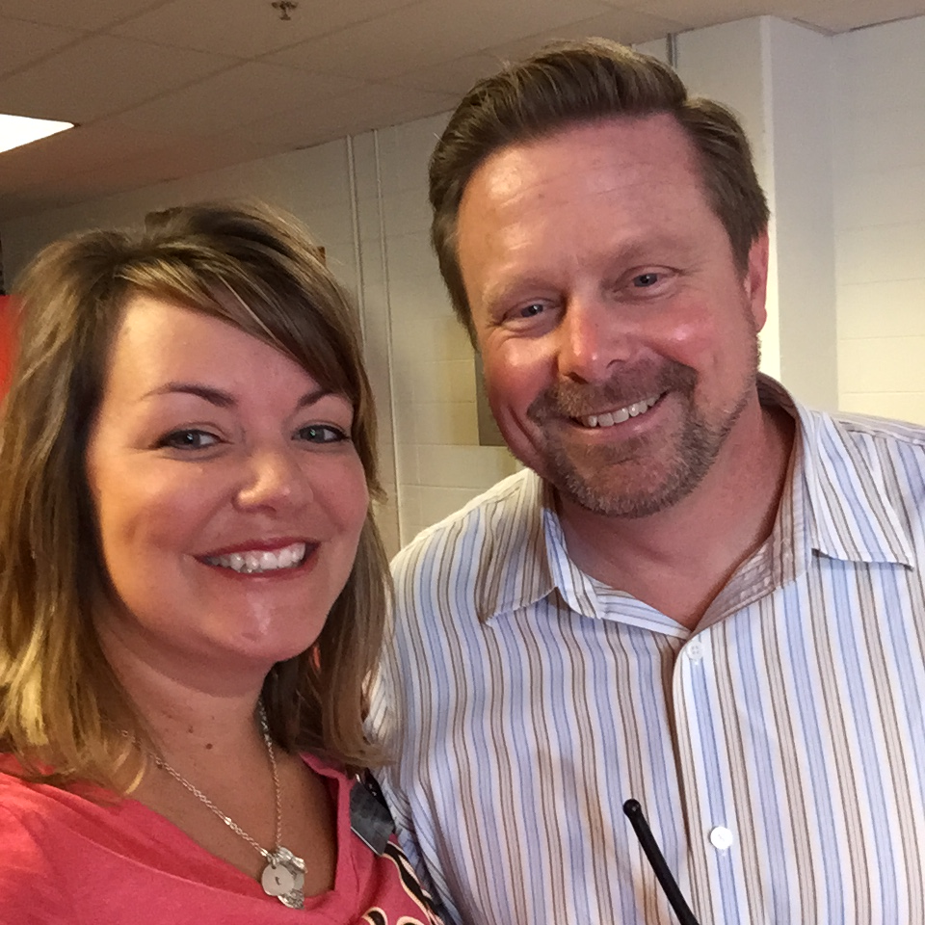
Brandon Hamilton, Director of Facilities for the Kansas City Chiefs

Slide 6
Conference T-Shirts Were a Hit

Slide 7
Jim Frisch, Manager of Operations Purina Animal Nutrition Center

Slide 8
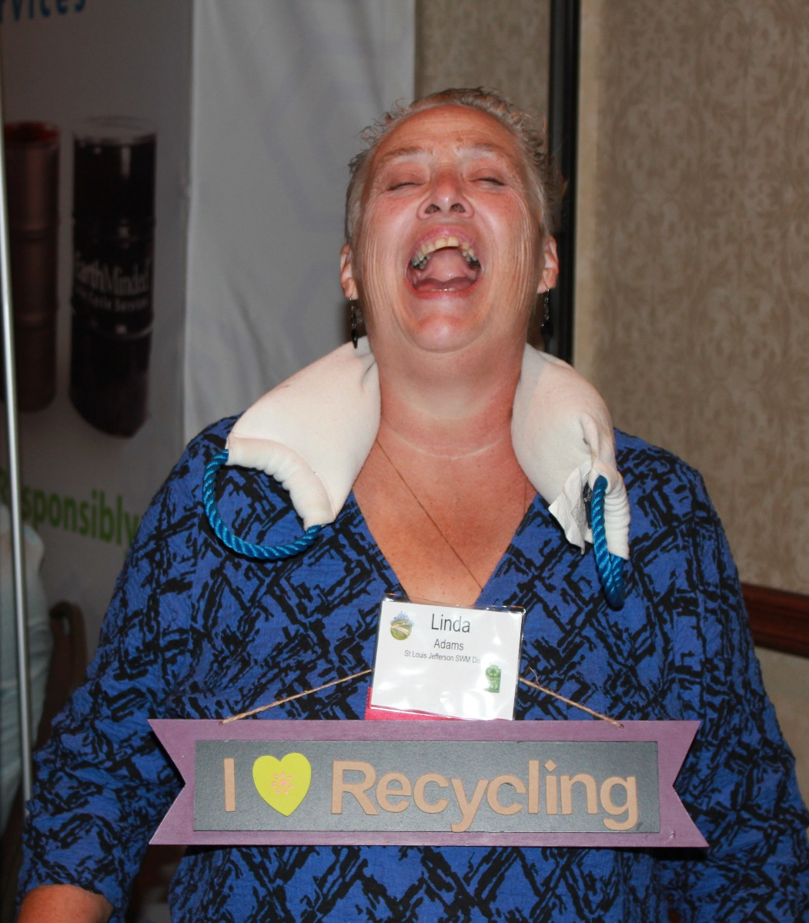
RecycleMore Pictures

Slide 9
Sponsor can include an ad on the Yapp App

